Slide 1





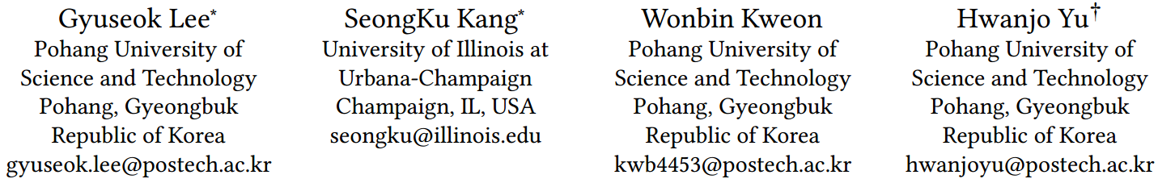





ATAI
Advanced Techniqueof Artificial Intelligence
ATAI
ChongqingUniversity _{AdvancedTechniqueof}
of Technology Artificial Intelligence
Chongqing University of
Technology
Chongqing University ^{ATAI}
_{of Technology} Advanced Techniqueof
Artificial Intelligence
Chongqing University of Technology
Chongqing University of Technology
Continual Collaborative Distillation for Recommender System
Code:None
2024.10.6 •ChongQing
—— KDD_2024
Reported by Shiyan Wu
1

Slide 2

ATAI
AdvancedTechniqueof
Artificial Intelligence
ATAI
ChongqingUniversity _{AdvancedTechniqueof}
of Technology Artificial Intelligence
ChongqingUniversity of Technology
Motivation
(1)Recent recommender systems use complex models like graph neural networks, which improve performance but increase computational costs and latency, necessitating a method to reduce these costs while maintaining efficiency.
(2) Existing knowledge distillation methods focus on static environments, ignoring dynamic data streams, resulting in inefficient frequent updates and a static student model, thus requiring a mechanism for continuous adaptation.

Slide 3

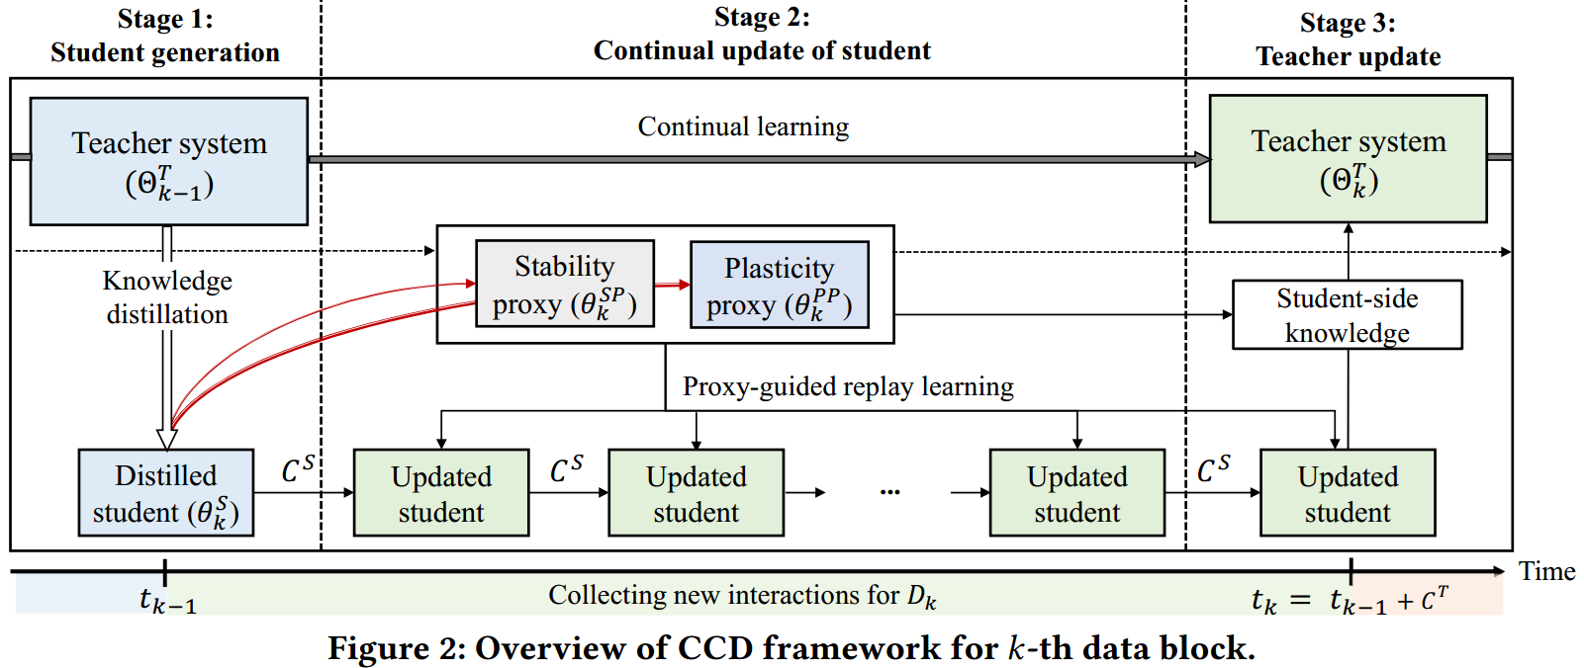
ChongqingUniversity of Technology
ATAI
AdvancedTechniqueof
Artificial Intelligence
ATAI
ChongqingUniversity _{AdvancedTechniqueof}
of Technology Artificial Intelligence
Overview

Slide 4
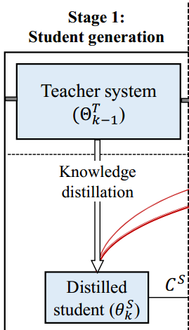

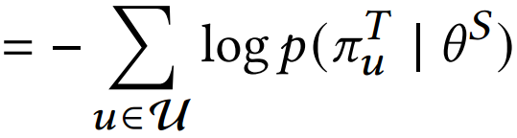
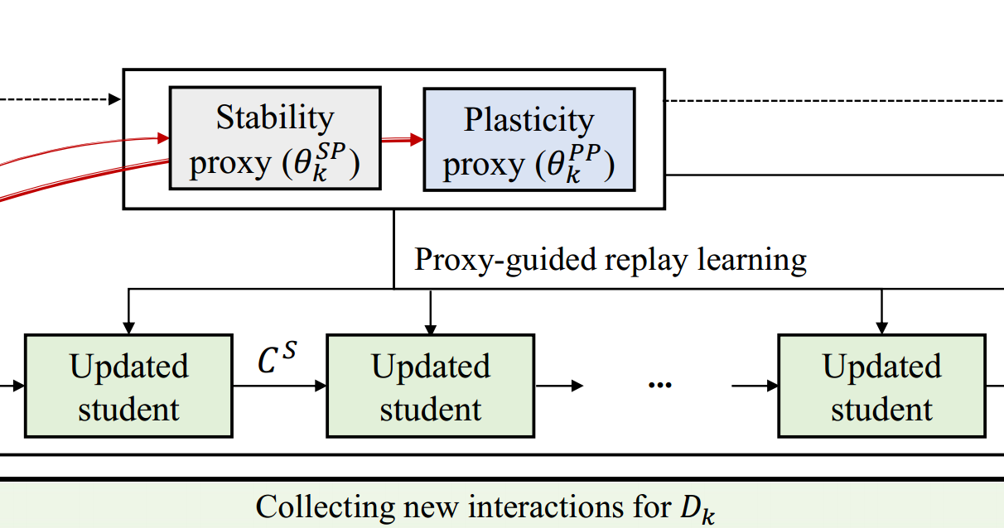
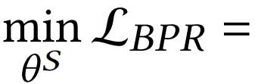
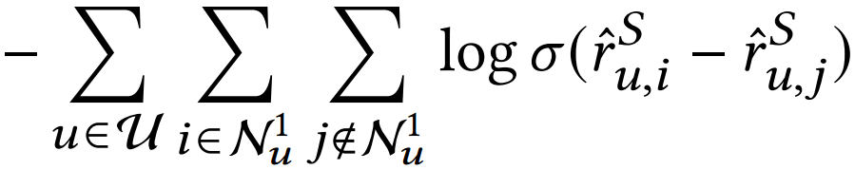
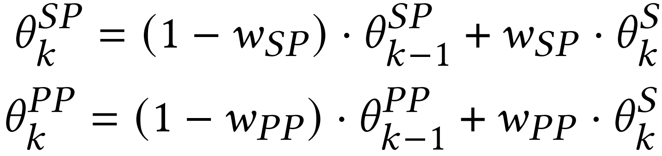
ChongqingUniversity of Technology
ATAI
AdvancedTechniqueof
Artificial Intelligence
ATAI
ChongqingUniversity _{AdvancedTechniqueof}
of Technology Artificial Intelligence
Method
(1)
(2)
(3)
(4)

Slide 5



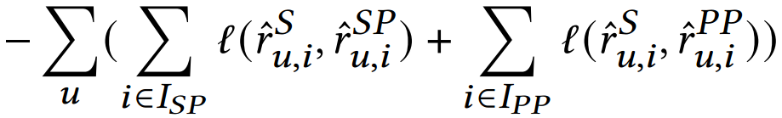
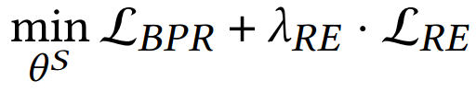
ChongqingUniversity of Technology
ATAI
AdvancedTechniqueof
Artificial Intelligence
ATAI
ChongqingUniversity _{AdvancedTechniqueof}
of Technology Artificial Intelligence
Method
(5)
(6)
(7)

Slide 6

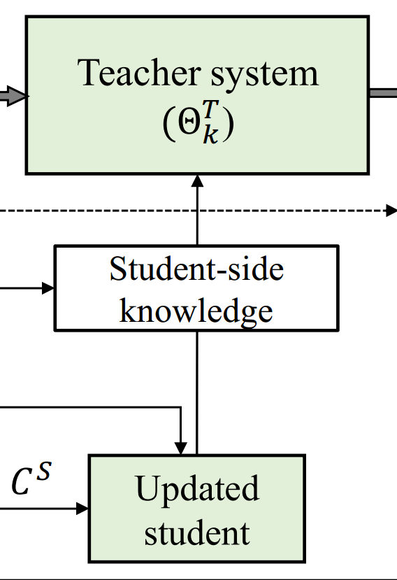

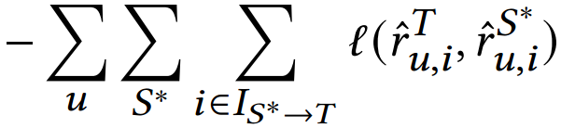
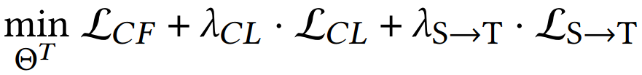
ChongqingUniversity of Technology
ATAI
AdvancedTechniqueof
Artificial Intelligence
ATAI
ChongqingUniversity _{AdvancedTechniqueof}
of Technology Artificial Intelligence
Method
(8)
(9)

Slide 7

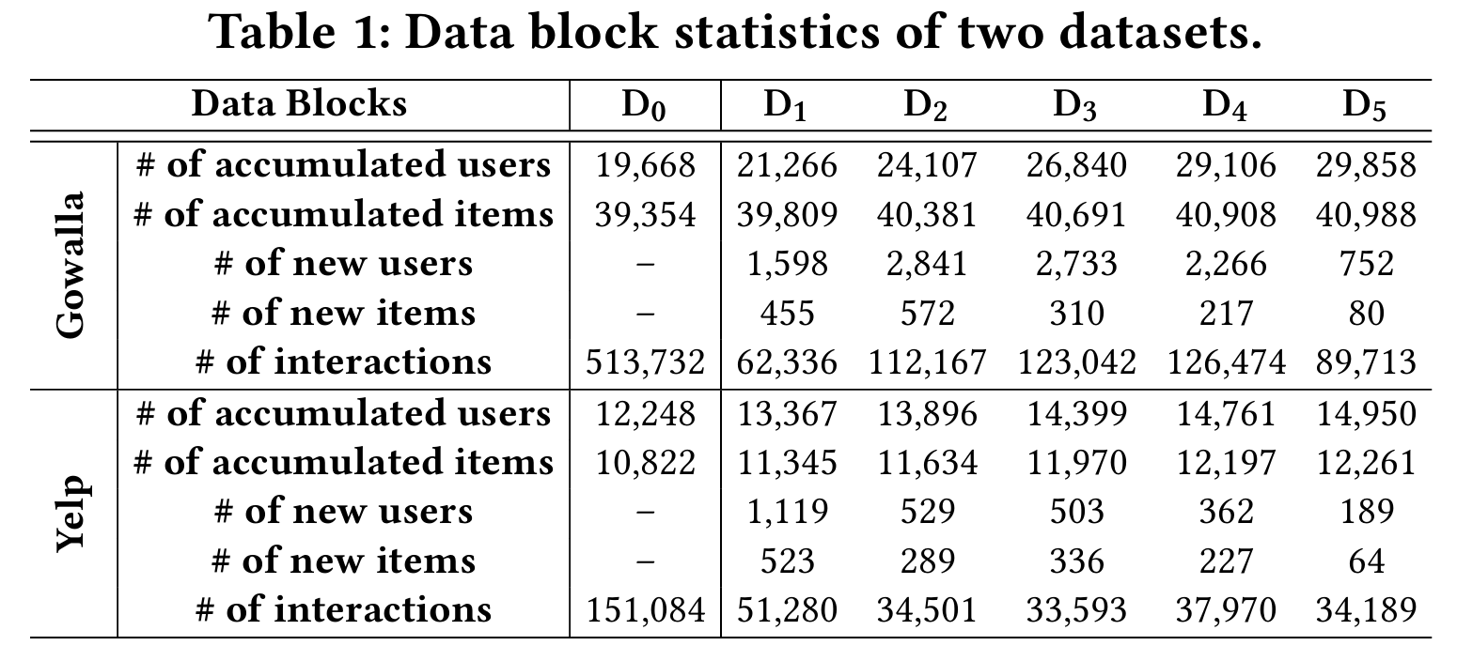
ATAI
AdvancedTechniqueof
Artificial Intelligence
ATAI
ChongqingUniversity _{AdvancedTechniqueof}
of Technology Artificial Intelligence
ChongqingUniversity of Technology
Experiments

Slide 8
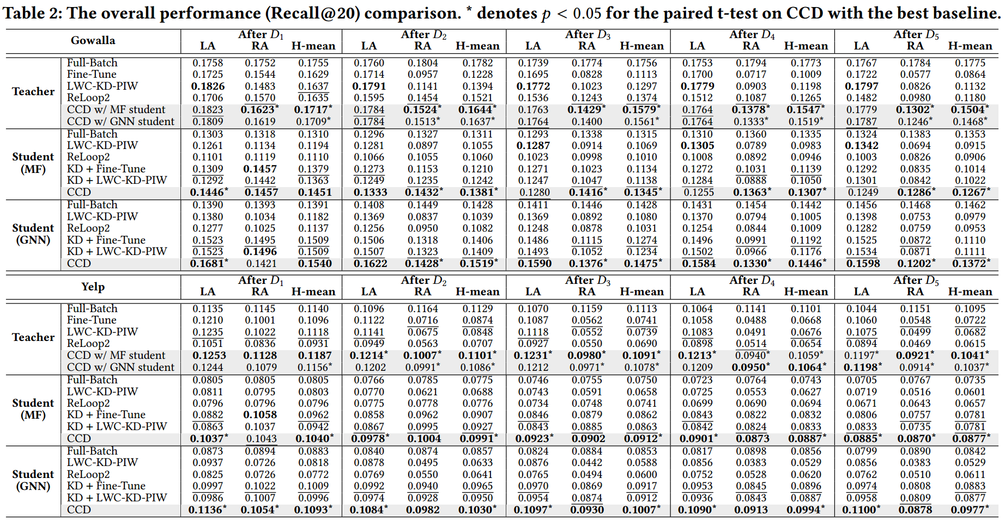
ATAI
AdvancedTechniqueof
Artificial Intelligence
ATAI
ChongqingUniversity _{AdvancedTechniqueof}
of Technology Artificial Intelligence
ChongqingUniversity of Technology
Experiments

Slide 9
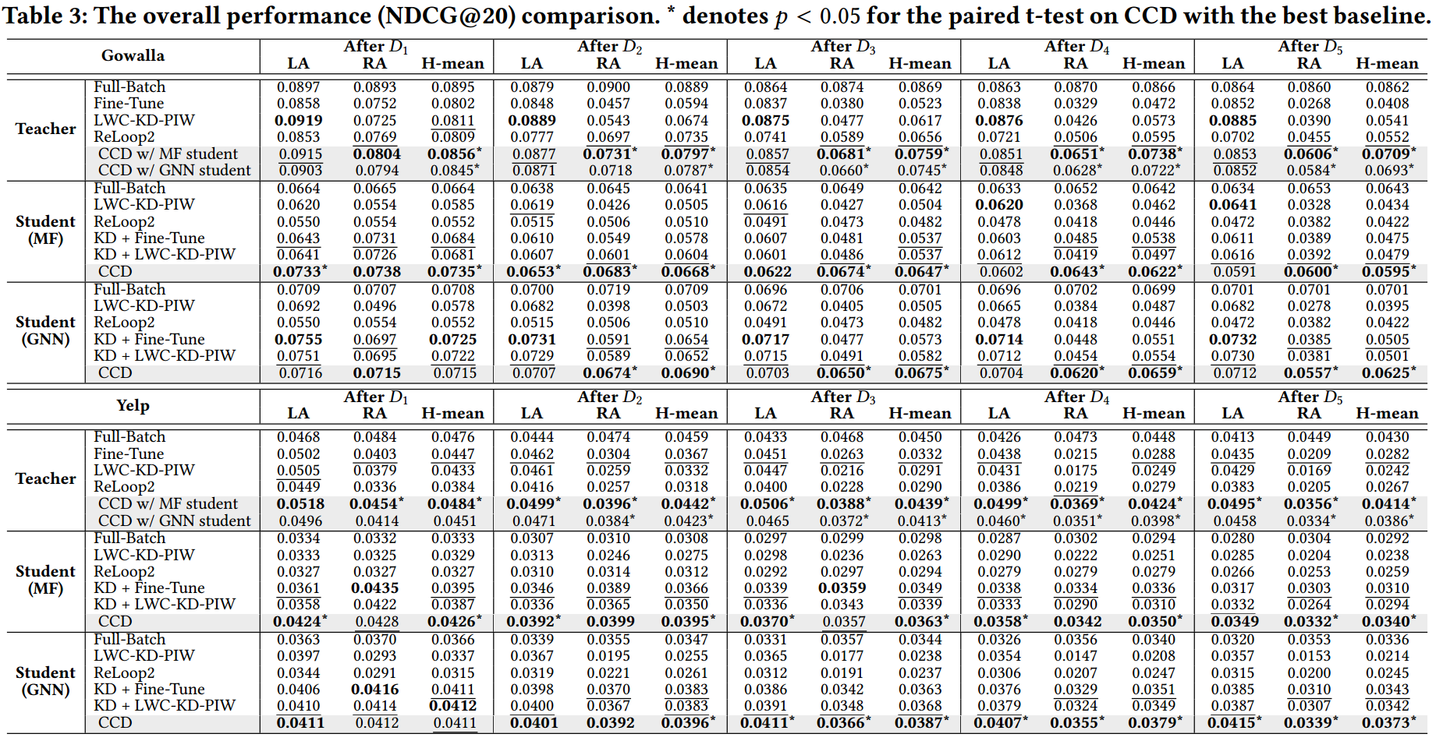
ChongqingUniversity of Technology
ATAI
AdvancedTechniqueof
Artificial Intelligence
ATAI
ChongqingUniversity _{AdvancedTechniqueof}
of Technology Artificial Intelligence
Experiments

Slide 10
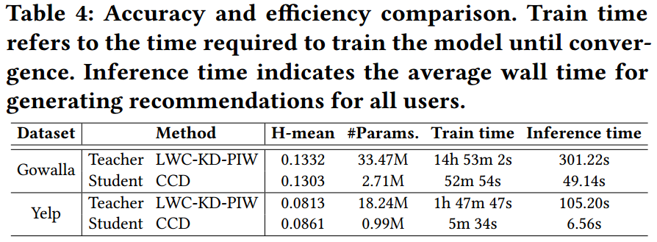
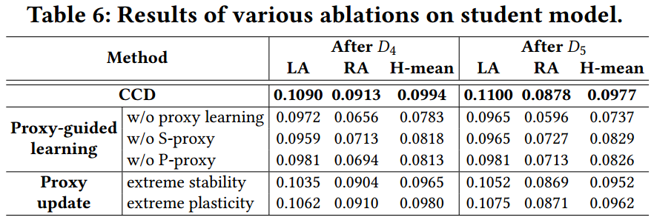
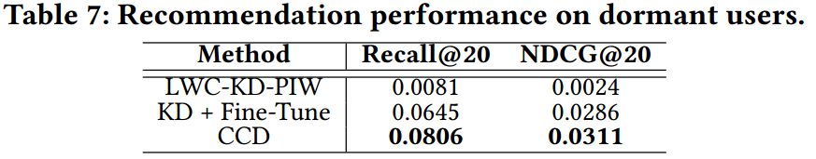
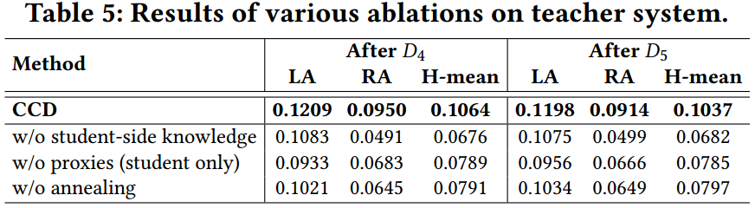
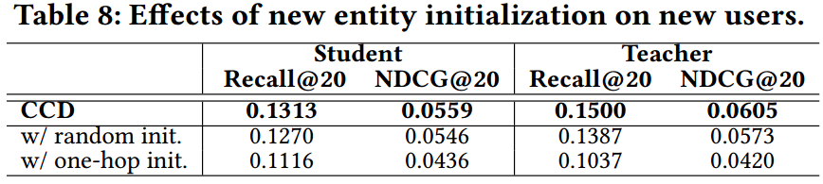
ATAI
AdvancedTechniqueof
Artificial Intelligence
ATAI
ChongqingUniversity _{AdvancedTechniqueof}
of Technology Artificial Intelligence
ChongqingUniversity of Technology
Experiments

Slide 11


ChongqingUniversity of Technology
ATAI
AdvancedTechniqueof
Artificial Intelligence
ATAI
ChongqingUniversity _{AdvancedTechniqueof}
of Technology Artificial Intelligence
Thanks!

